Slide 1
Advanticsys
Weekly update – 19/05/2023
Introduction on jupyter notebooks developed, function of each file
Show manual instructions
Demonstrate final dashboard which shows abnormal detection outcomes
Briefly discussion on presentation to whole class on 31/05/2023

Slide 2
Guidance for Development Inverters generate less energy is abnormal

Slide 3
Process from raw data to final report
Raw Data
34 files for each year
Today_Energy, Total_energy, Inv_temp, wms_temp, wms_irradiaance
Clean data
Remove outliers and possible data error
Apply ML model
Make energy prediction for each minute based on Temp, Irradiance
Combine act and predictions
Add prediction into actual data file
combine into 15 mins interval
Conduct statistical analysis
identify inverters significantly produce less power with high irradiance level
Final report
update Tableau dashboard with new data

Slide 4
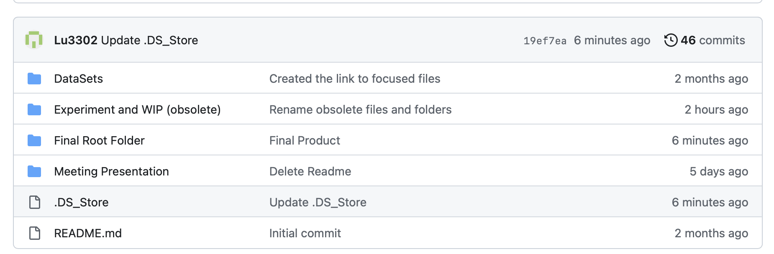
Location of files developed
Link to GitHub: https://github.com/Lu3302/Advanticsys
2 Folders include useful files
Meeting presentation: slides showed in each Fri meeting
Final Root Folder: Working files, models and Final Abnormal detection Dashboard
Can be download and run on private laptop to update new data and daily report

Slide 5
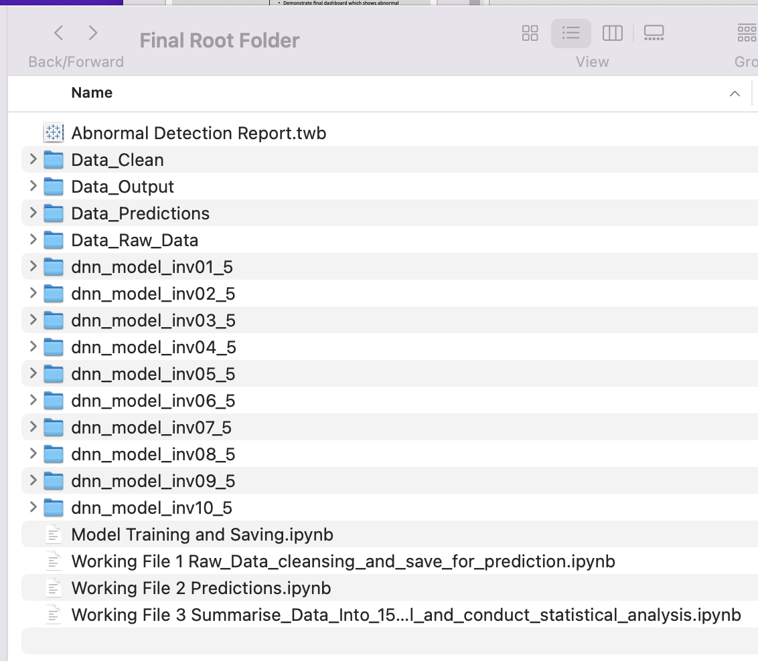
List of files in final root folder
Best model for each inverter has trained and saved, no need to train the models again for report update

Slide 6

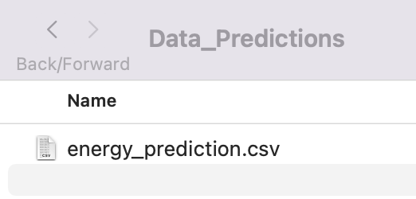
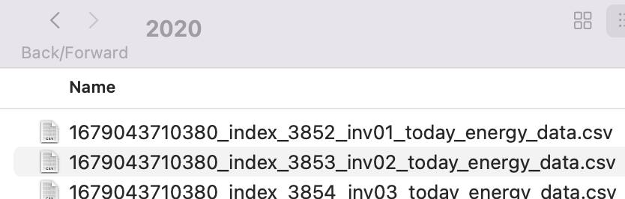

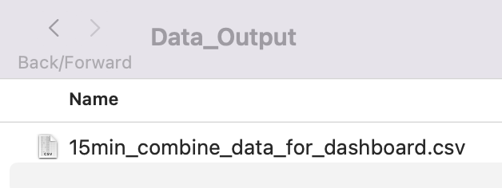
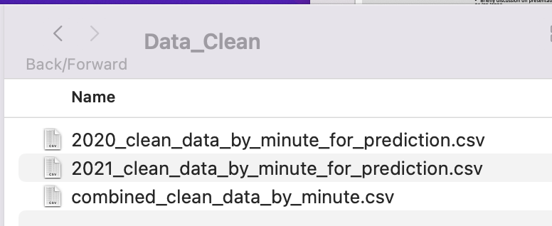

Working process to get daily report
Step 3 – run working file 2 to get energy prediction by minute
Step 1 – save raw data into folder
Step 2 – run working file 1 to clean and combine data
Step 4 – run working file 3 to combine actual and predictions to 15 mins interval and conduct statistical analysis
Step 5 – once get combined output data, open Tableau and the report will update

Slide 7


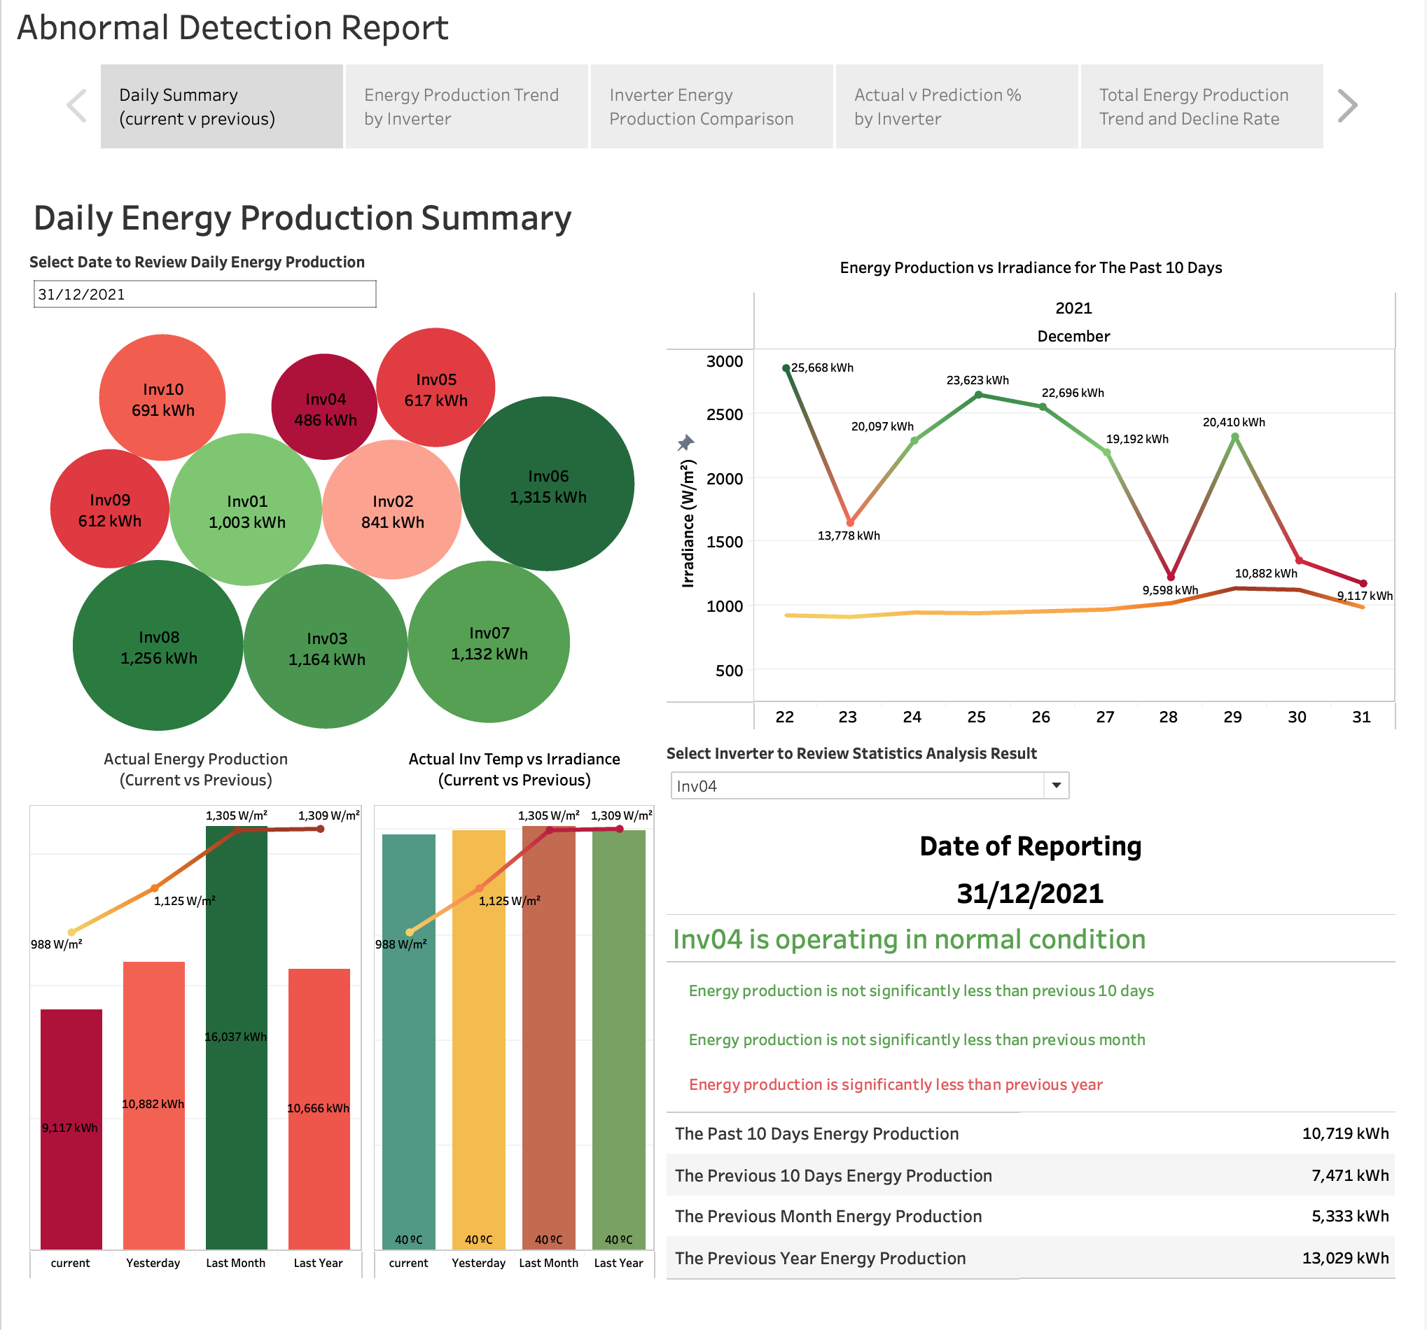
By following the working process
+
Tableau subscription
15 mins Labour
Daily abnormal detection report

Slide 8
Final dashboard
4 ways to identify abnormal inverters and support decision making
Visualization - get impression on possible abnormal inverters
Result from statistical analysis on actual data – identify inverters significantly produce less energy in constant or higher irradiance level compare to previous period (currently set as 10 days period, can adjust the comparison period length in working file 1)
Visualized summary show actual verse prediction – find the inverters have actual energy show large deviation from prediction
Total energy production trend show decline rate - identify inverters decline faster

Slide 9
Visualization 1 – Daily summary
Select a date to review energy produced by each inverter
Possible abnormal if high power inverter produced less energy
Compare current date energy production with previous periods
review the correlation between energy and irradiance level
Possible abnormal if inverter produced less energy than previous periods at high irradiance level

Slide 10
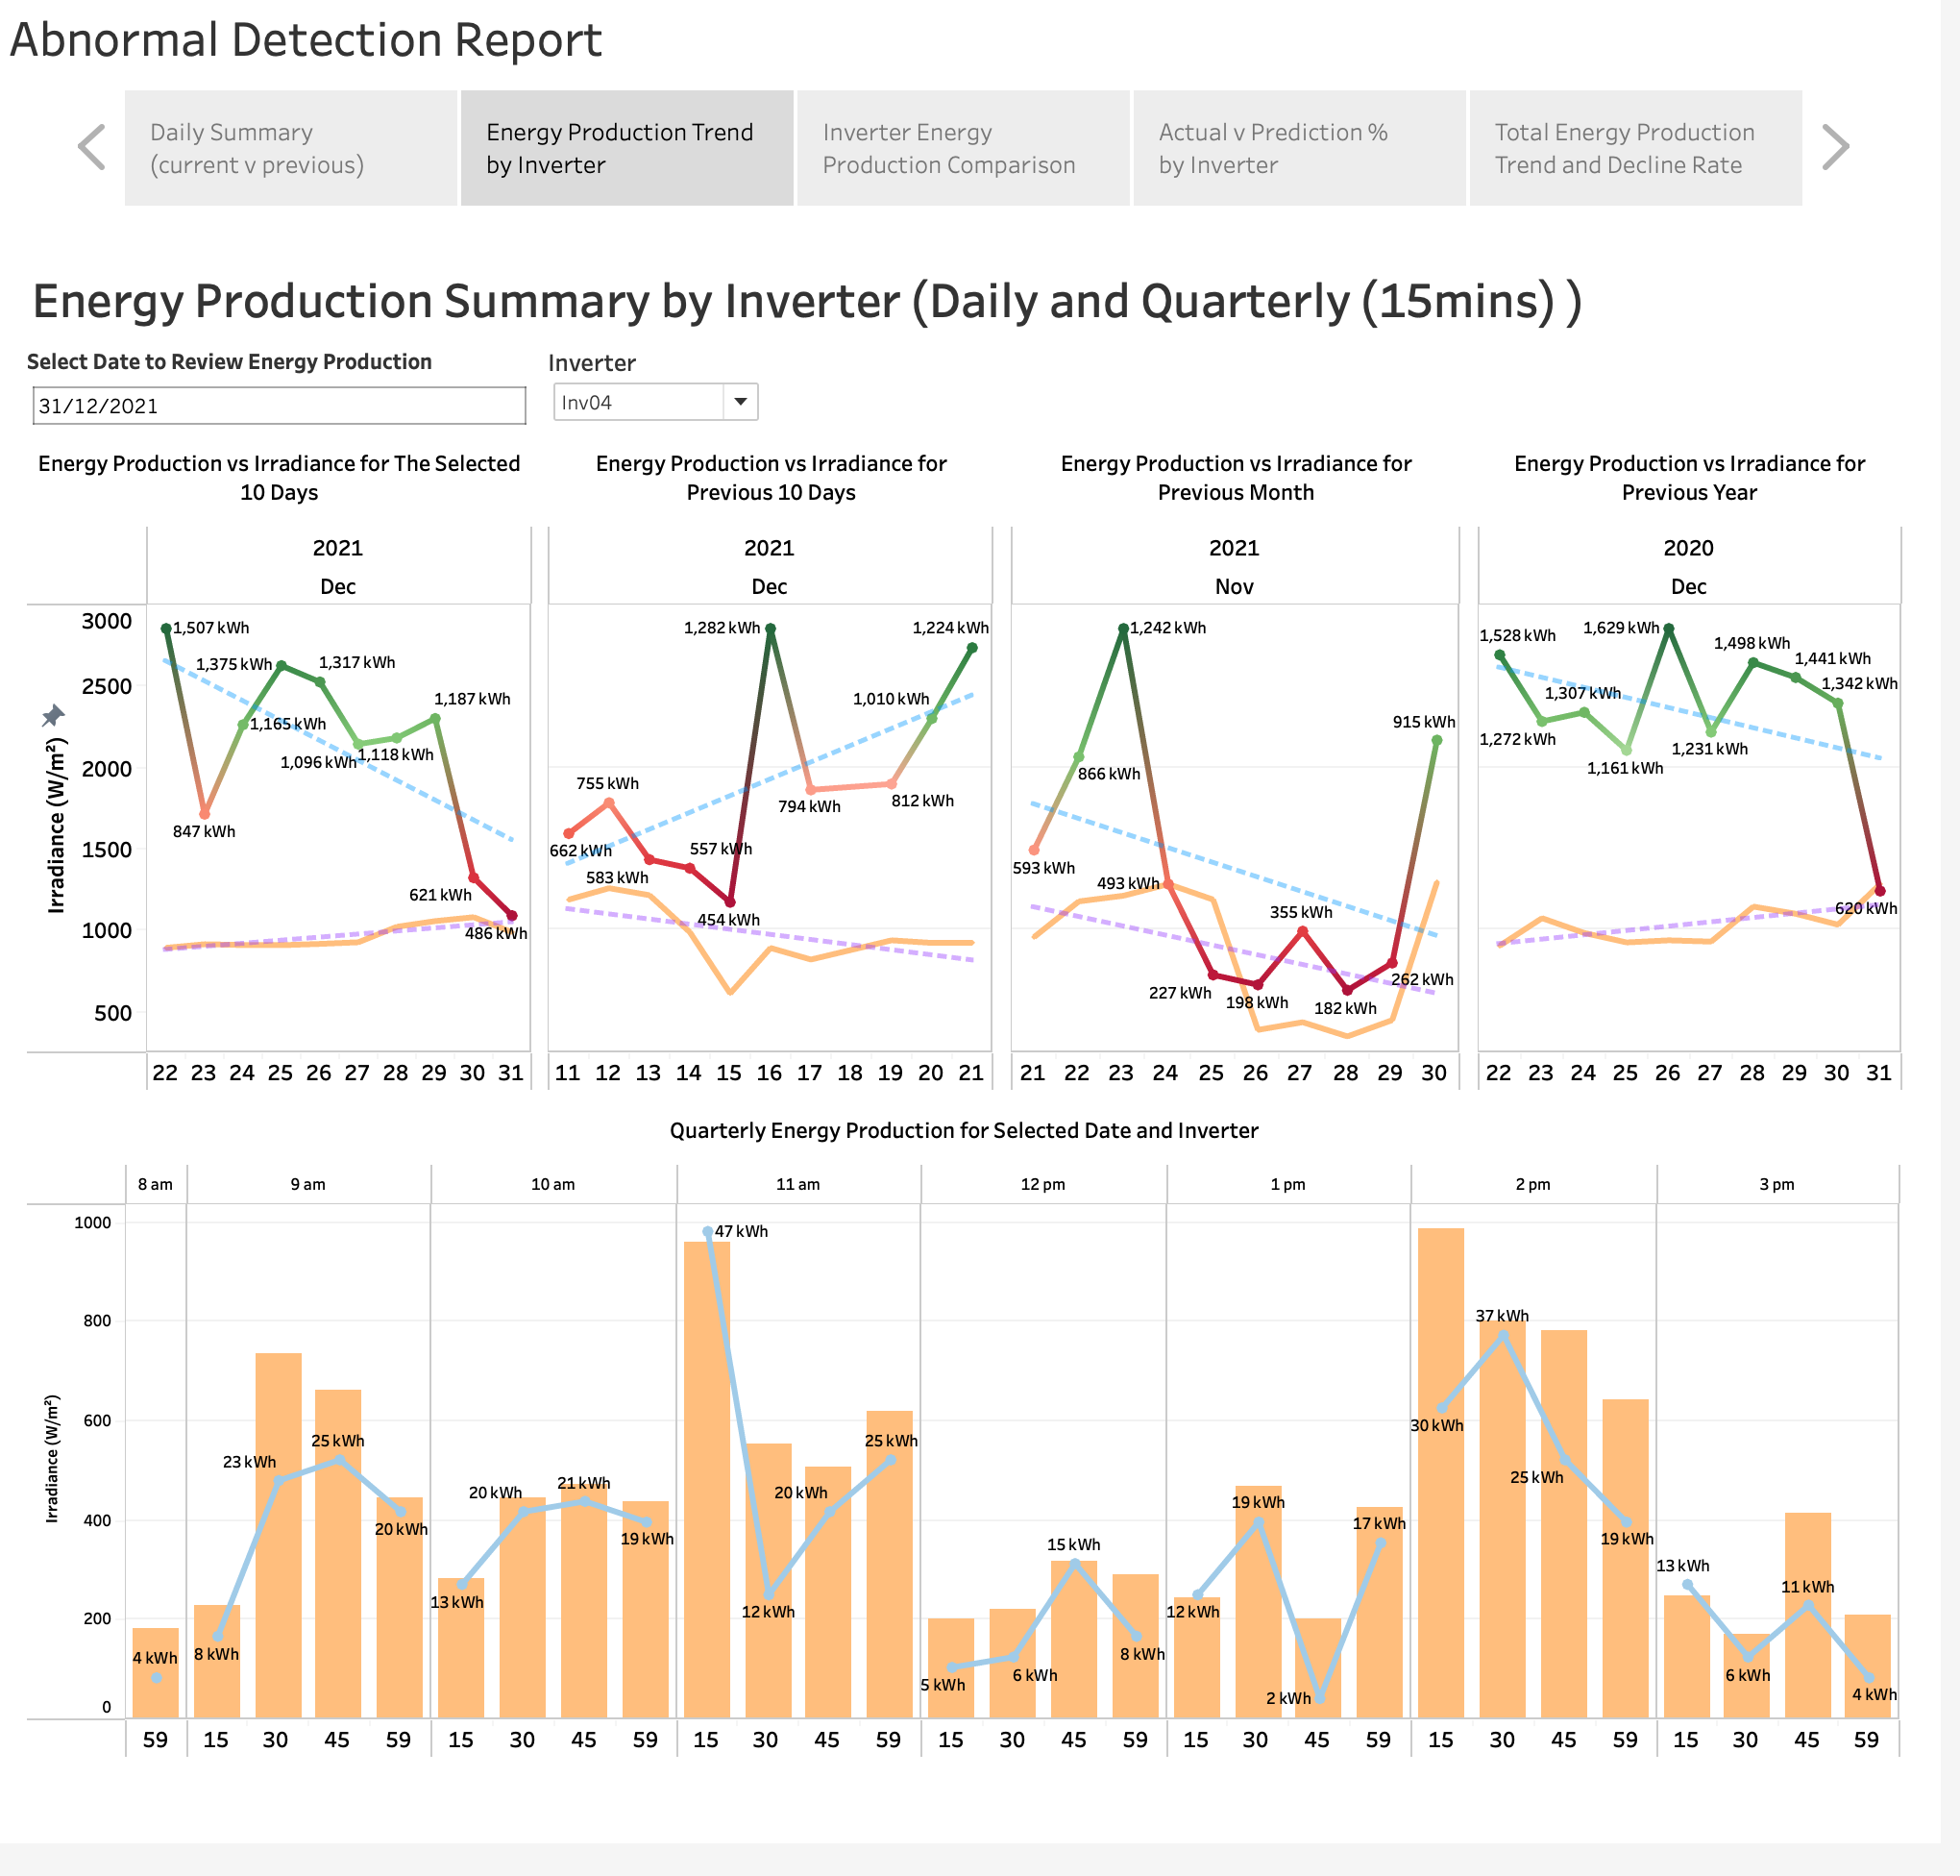
Visualization 2 – Trend summary
Select a date and we can review 10 days energy production and irradiance level for current and previous periods
Possible abnormal if there is negative trend in energy production with positive trend in irradiance level
We can also review the quarterly (15 mins) energy production and irradiance level to find possible reasons the energy production is low in a day with high irradiance level
Possible abnormal if the energy production amount is not follow the irradiance level change

Slide 11
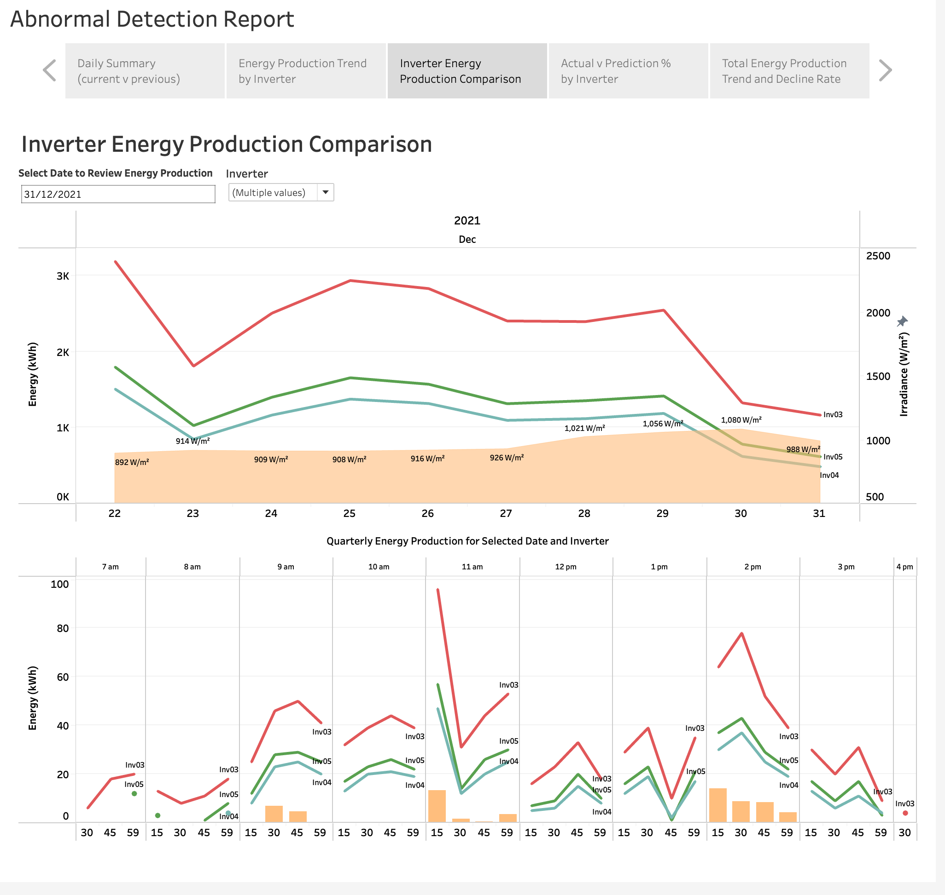
Visualization 3 – Comparison between inverters
Select a date and we can compare 10 days energy production in same irradiance level between inverters
You can also view the energy production in each 15 mins interval for the select date
In this summary, you can find capacity of each inverters.
You can also identify possible abnormal if you see a high capacity inverter produced less energy than lower capacity inverter

Slide 12
Result from statistical analysis
Select an inverter, the report will show you the outcome from statistical analysis, the analysis period is the past 10 days as at reporting date
If current period is significantly producing less power than previous period with similar or higher irradiance, the report will show the inverter is abnormal
Otherwise, it will show the inverter is operating normally

Slide 13
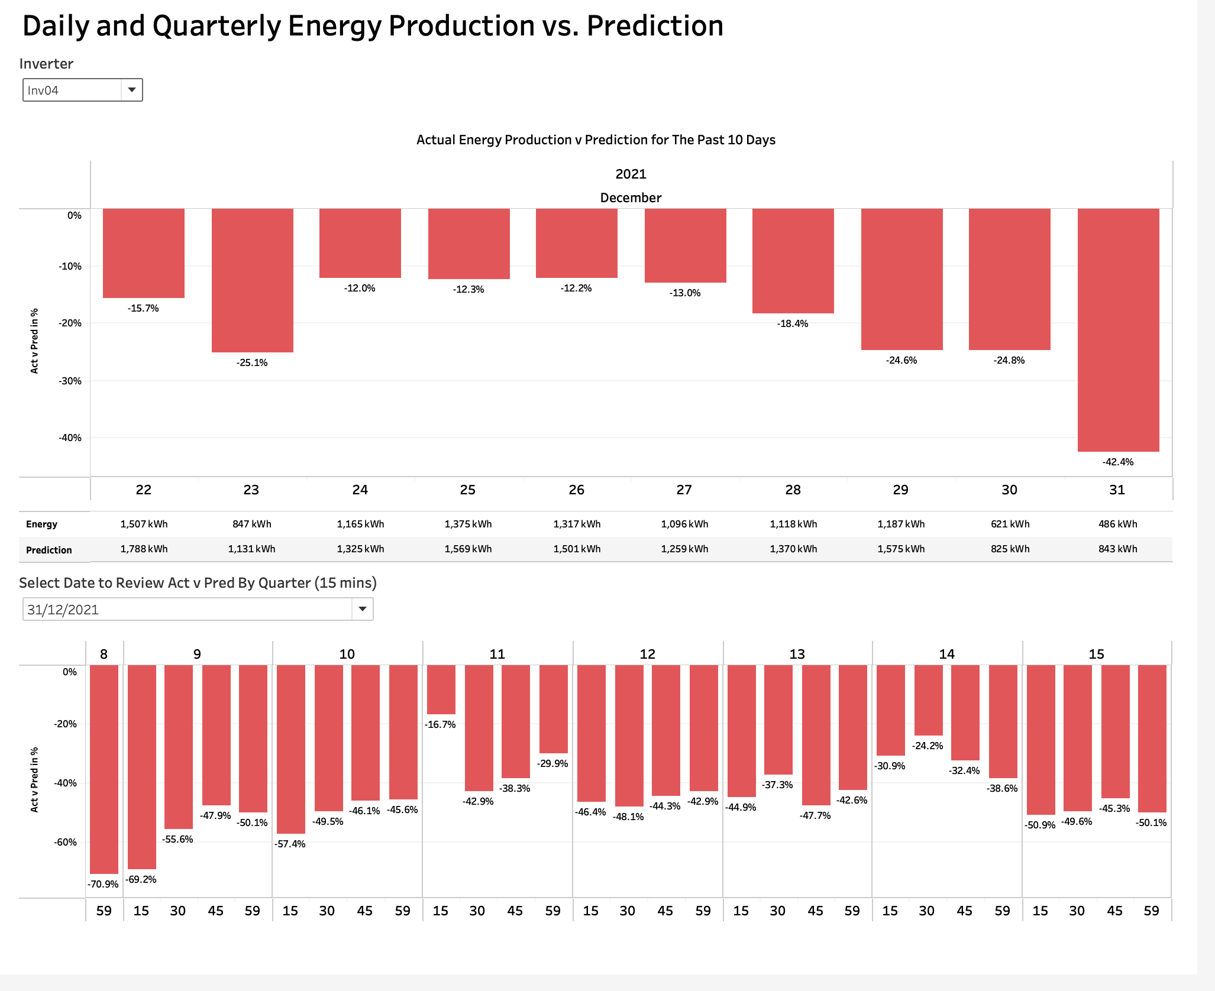
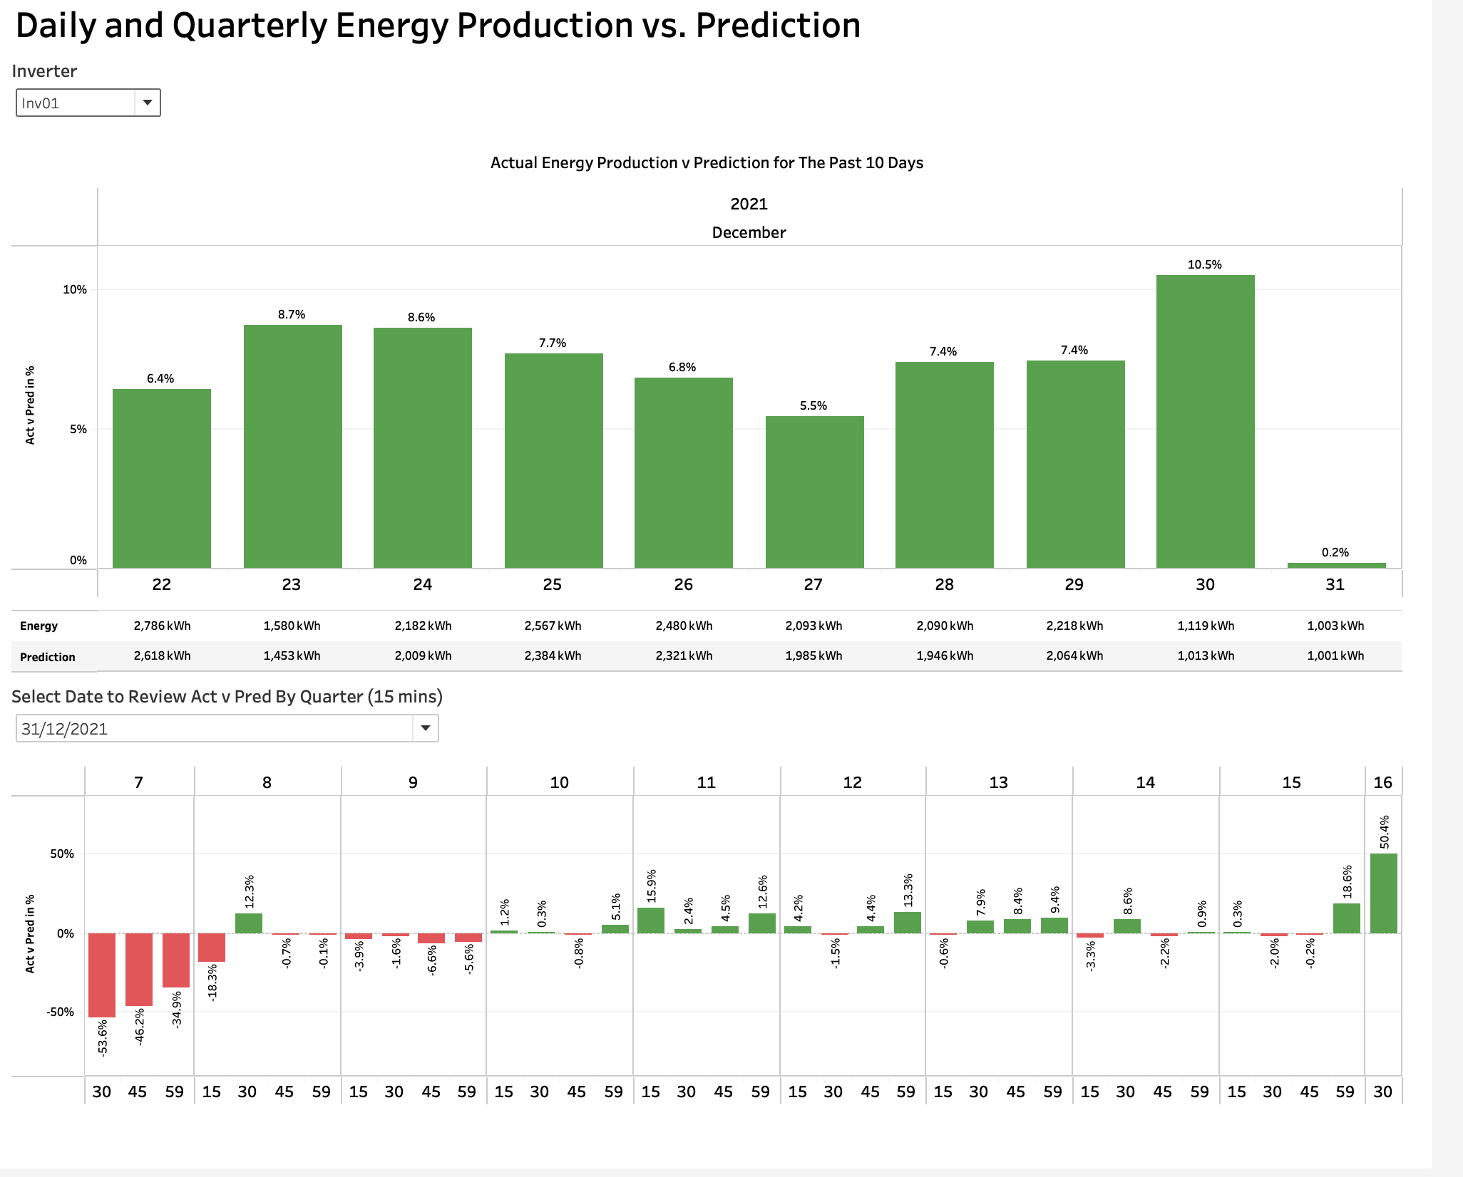
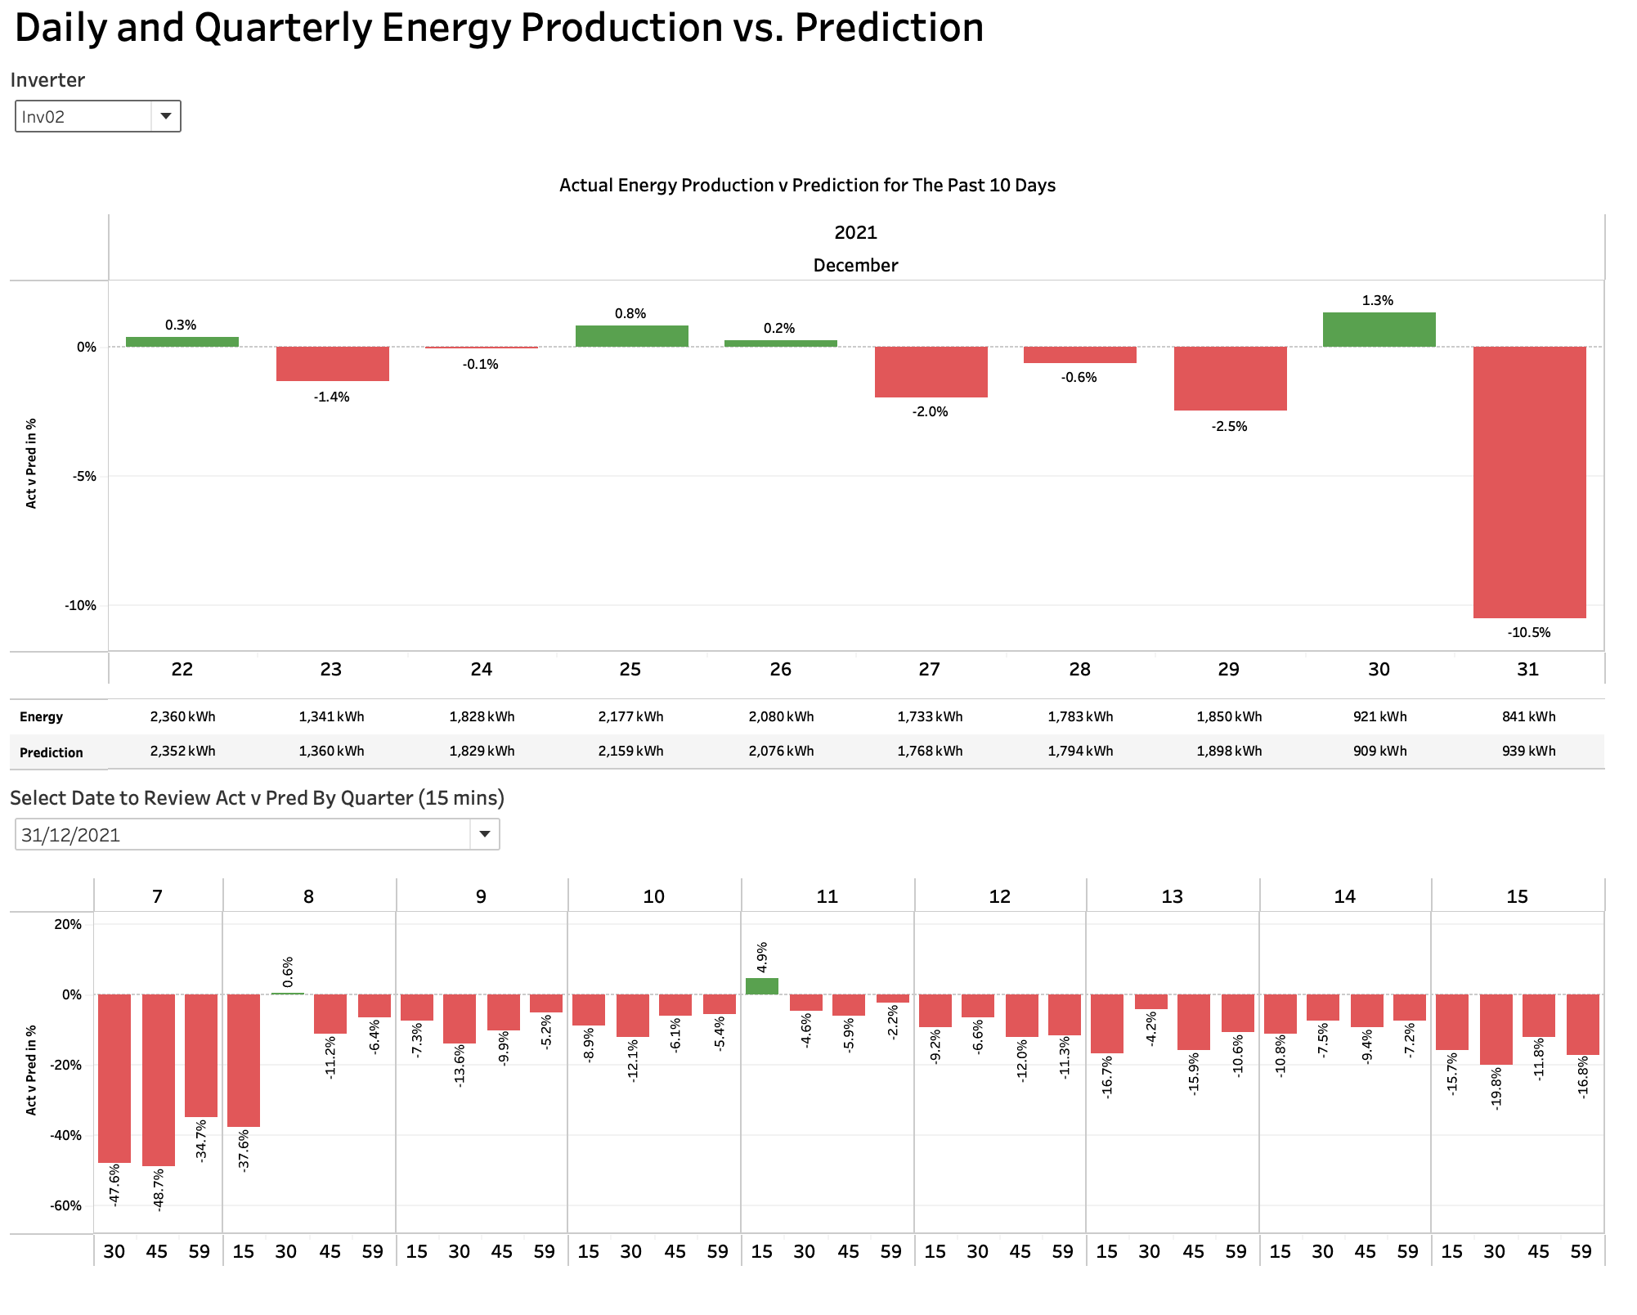
Actual vs. Prediction
Prediction has been calculated by applying ML models
You can select an inverter or multiple inverters to review actual energy production vs. prediction for the past 10 days before reporting date
You can also see the actual vs. prediction by quarter (15 mins)
You can use this summary to help abnormal detection if the inverter produced less energy than prediction constently

Slide 14
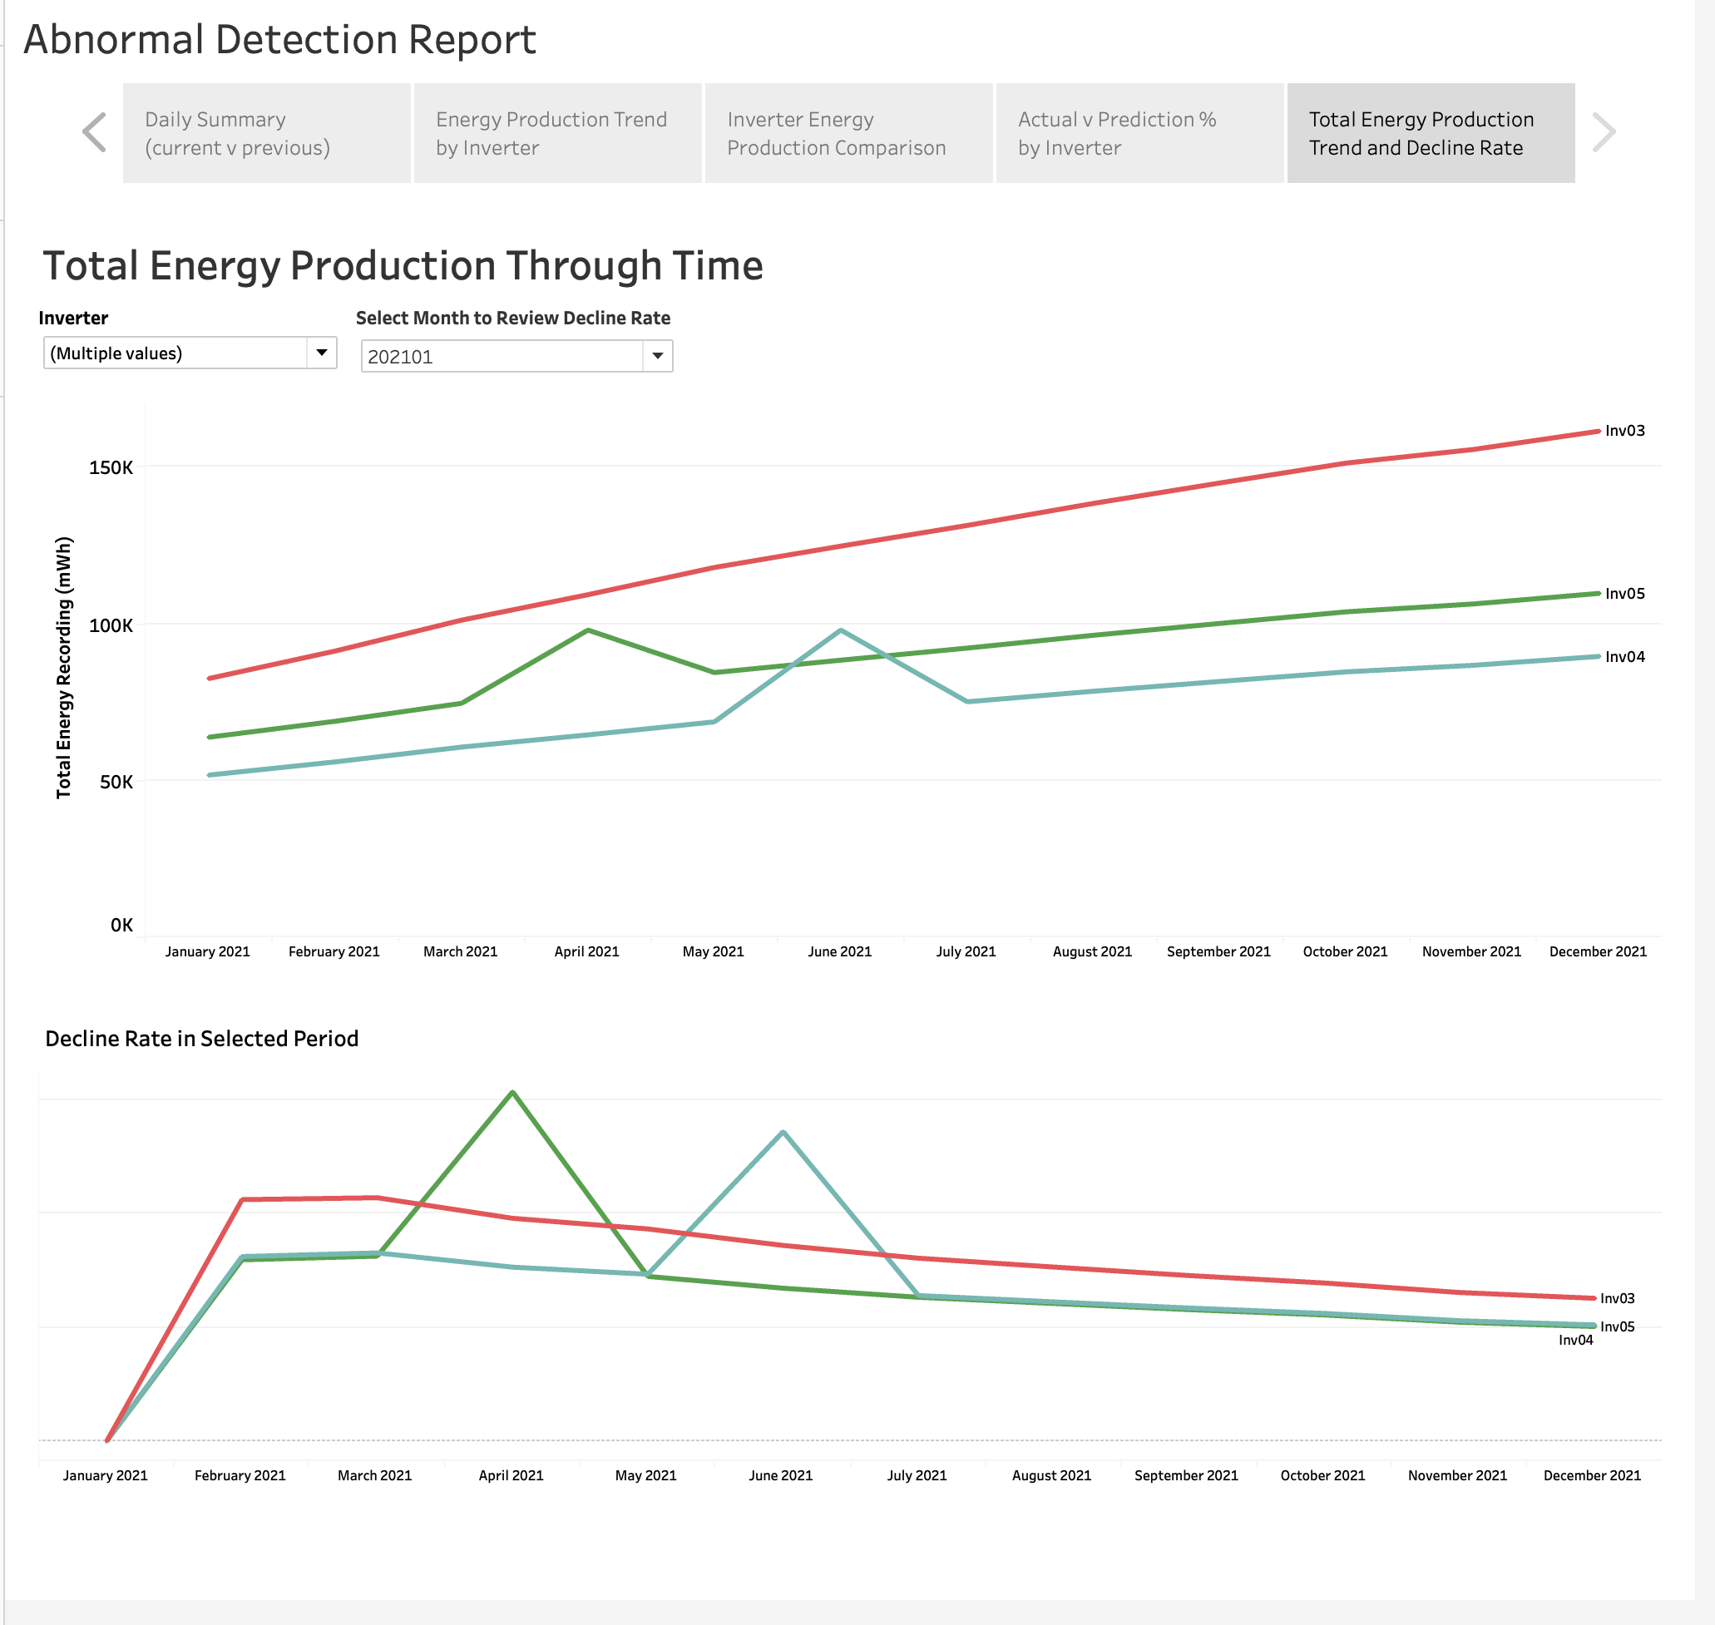
Total energy production trend and decline rate
From the last summary, you can select inverters and starting period to review the total energy produced overtime and the rate of decline overtime
The inverter show flat trend means energy production ability decline faster
The bottom chart can give you the idea when the inverter start producing less power

Slide 15
By combining the 4 parts in the report, users will be able to review the inverter performance completely. Users should be able to use the report to help make decision on abnormal investigation or maintenance planning

Slide 16
Demonstration of final dashboard

Slide 17
Approval of contents share in presentation to class
Data description – energy production is closely related to irradiance
Trend graph for actual production
Actual vs Prediction summary
Trend of total energy generation and capacity decline rate

Slide 18
Thanks for the support
Qi Lu
Joyal Joy Madeckal
Denis Vaghasia
26/05/2023

